Slide 1
CSC 240 Final Presentation
Gianna Williams

Slide 2
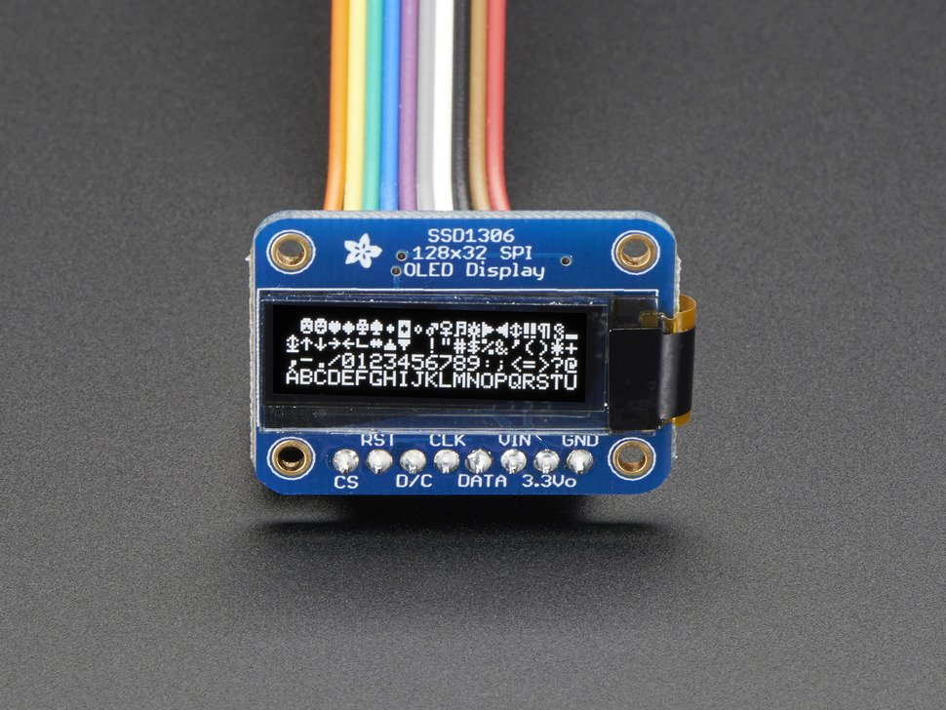
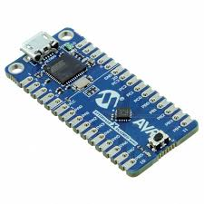
Components
Attiny 416
SPI OLED
Wires
The Pins used
PA1=DATA
PA3=CLK
PA4=RST
PA5=CS
PA6=DC
PC2=PLAYER B SCISSOR BUTTON
PC1=PLAYER B PAPER BUTTON
PC0=PLAYER B ROCK BUTTON
PB0= PLAYER A ROCK BUTTON
PB1=PLAYER A PAPER BUTTON
PB2=PLAYER A SCISSOR BUTTON
PB3=CLEAR BUTTON

Slide 3
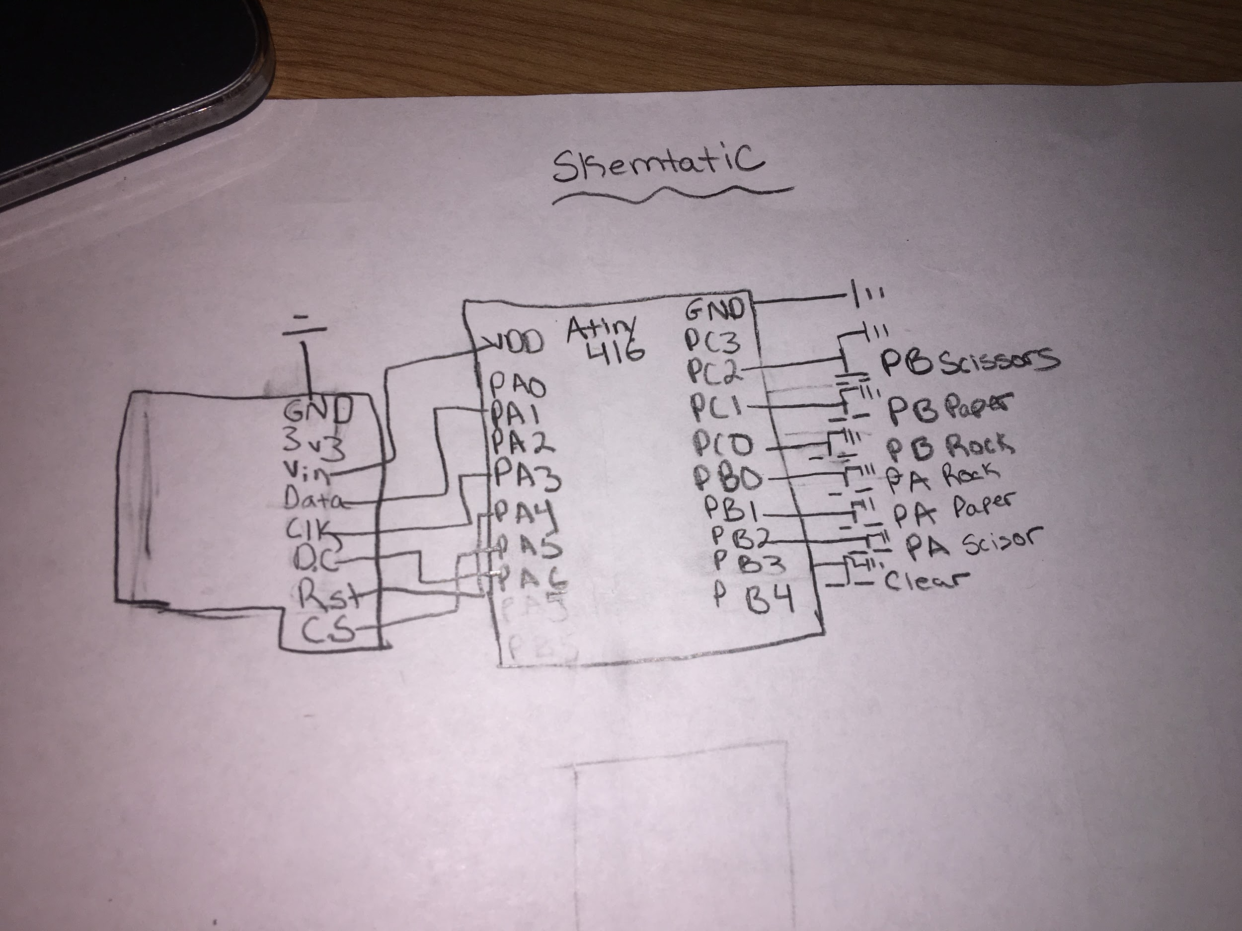
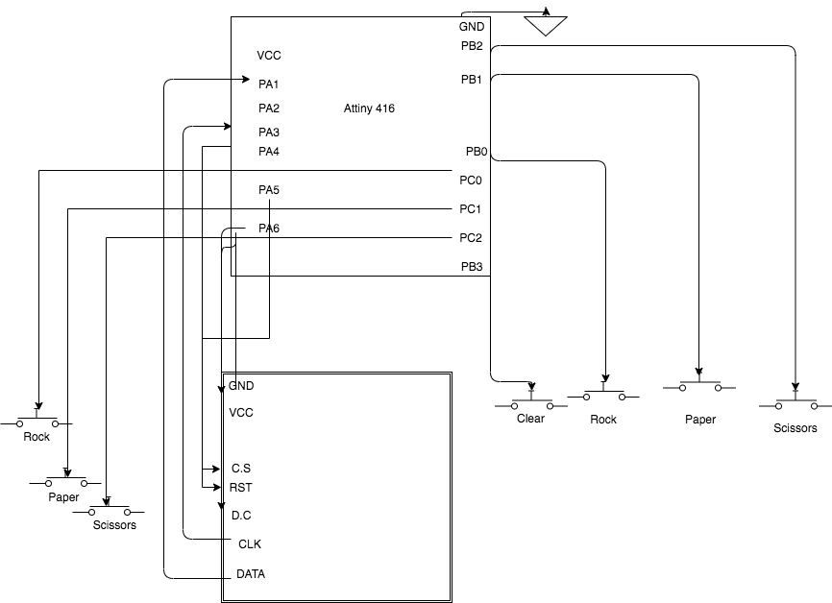
Schematic
Notes:
PA1=DATA
PA3=CLK
PA4=RST
PA5=CS
PA6=DC
PC2=PLAYER B SCISSOR BUTTON
PC1=PLAYER B PAPER BUTTON
PC0==PLAYER B ROCK BUTTON
PB0= PLAYER A ROCK BUTTON
PB1=PLAYER A PAPER BUTTON
PB2=PLAYER A SCISSOR BUTTON
PB3=CLEAR BUTTON
A pull-up resistor connects unused input pins (AND and NAND gates) to the dc supply voltage, (Vcc) to keep the given input HIGH.

